Slide 1
NOAA-TM-NMFS-SWR-044:
Understanding the co-occurrence of large whales and commercial fixed gear fisheries off the west coast of the United States
West Coast Region
Lauren Saez, Dan Lawson, Monica DeAngelis, Elizabeth Petras, Sarah Wilkin, and Christina Fahy
California Marine Mammal Stranding Network Meeting
February 2014

Slide 2
Co-occurrence model
Assess entanglement risk by overlaying fishery effort with species-specific whale distribution patterns to produce relative co-occurrence scores
Simple model:
  Co-occurrence score = Fishery landings x whale density
  Fishery landings and whale densities were scaled 1 to 7
  11 fixed gear fisheries (trap, bottom set longline, and set gillnet)
  5 whale species (blue, fin, gray, humpback, and sperm)

Slide 3
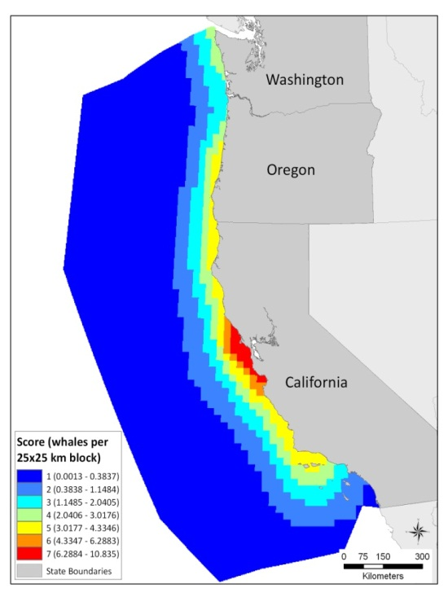
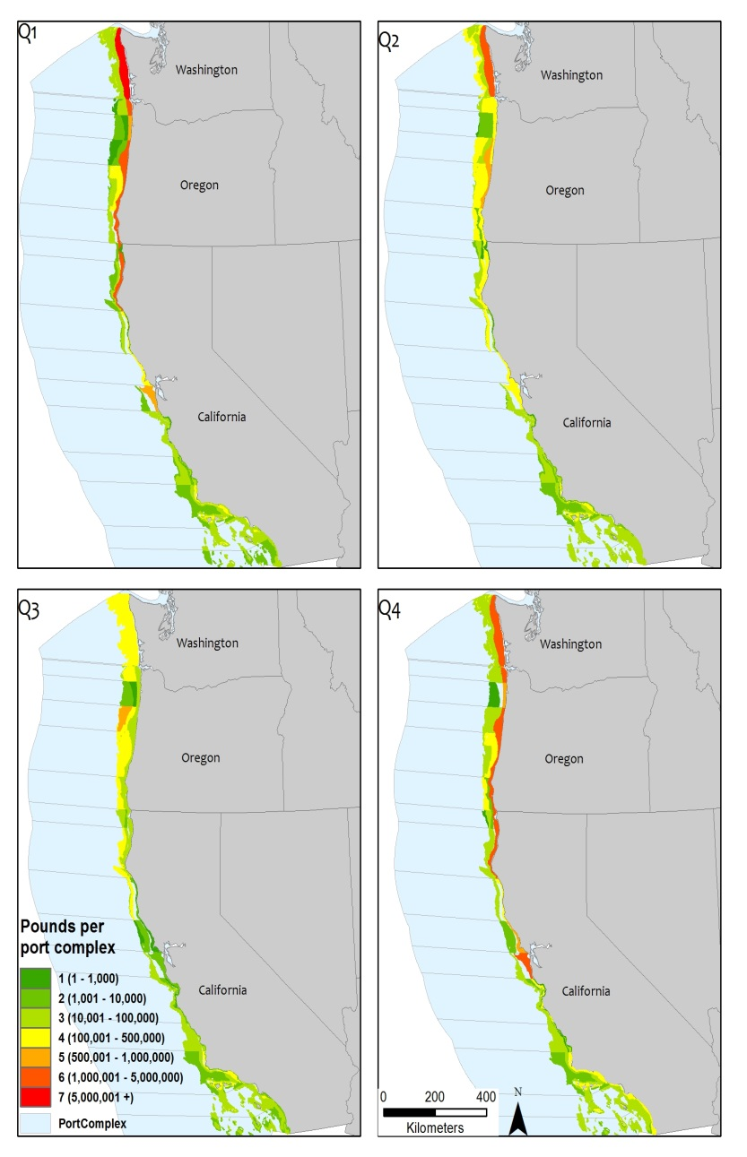
Co-occurrence model walk-through
Humpback whale
Fixed gear commercial fisheries
Scaled whale density (1 to 7) multiplied by scaled fixed gear commercial fishing effort (1 to 7) results in a co-occurrence score (1 to 49)

Slide 4
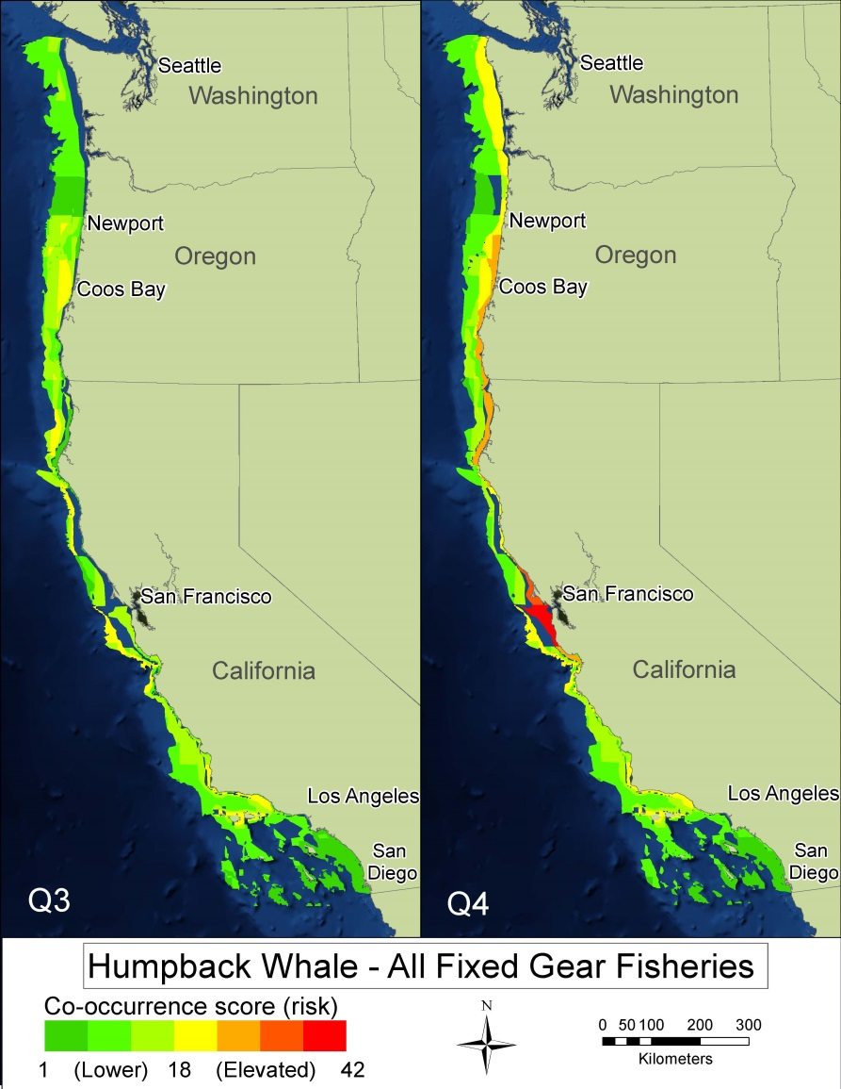
Co-occurrence map of humpback whales with all 11 fixed gear fisheries

Slide 5
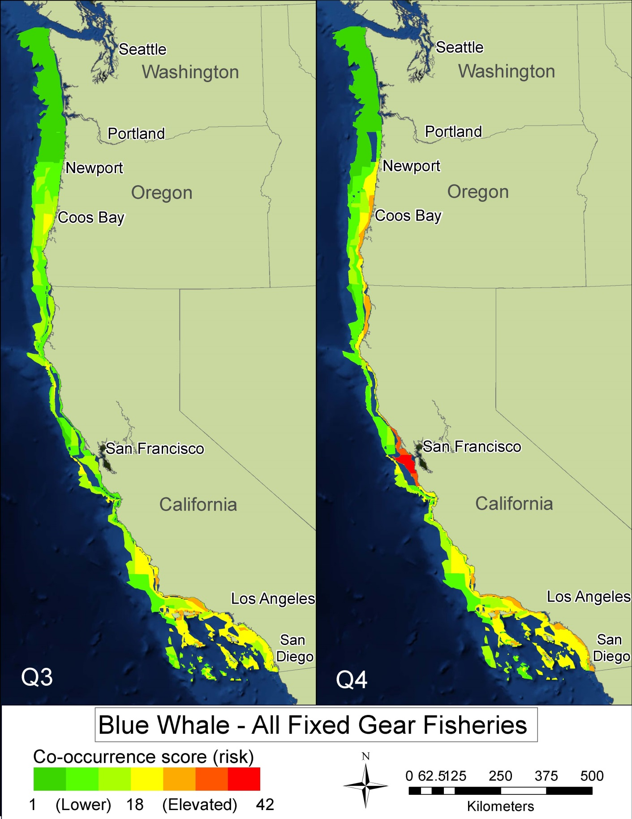
Co-occurrence map of blue whales with all 11 fixed gear fisheries

Slide 6
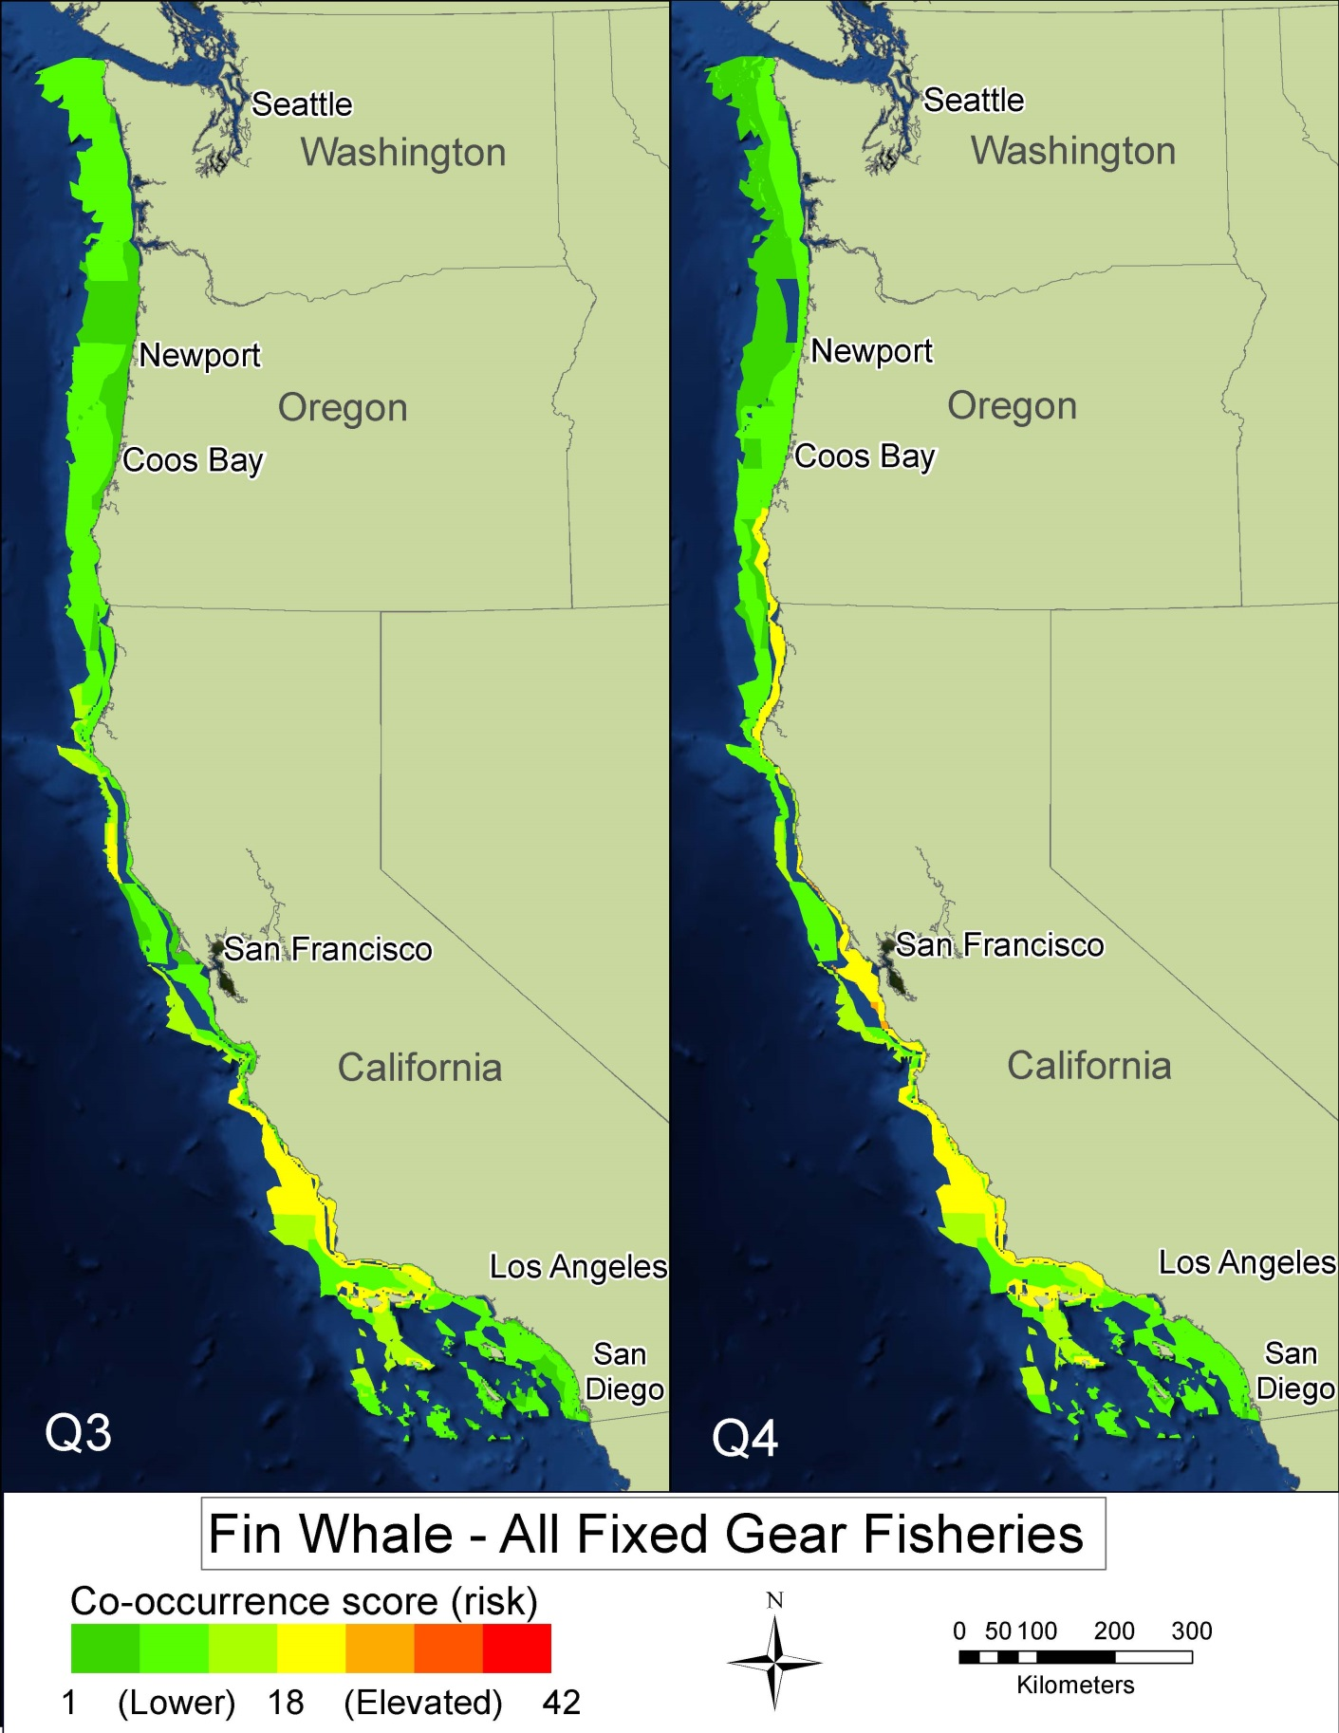
Co-occurrence map of fin whales with all 11 fixed gear fisheries

Slide 7
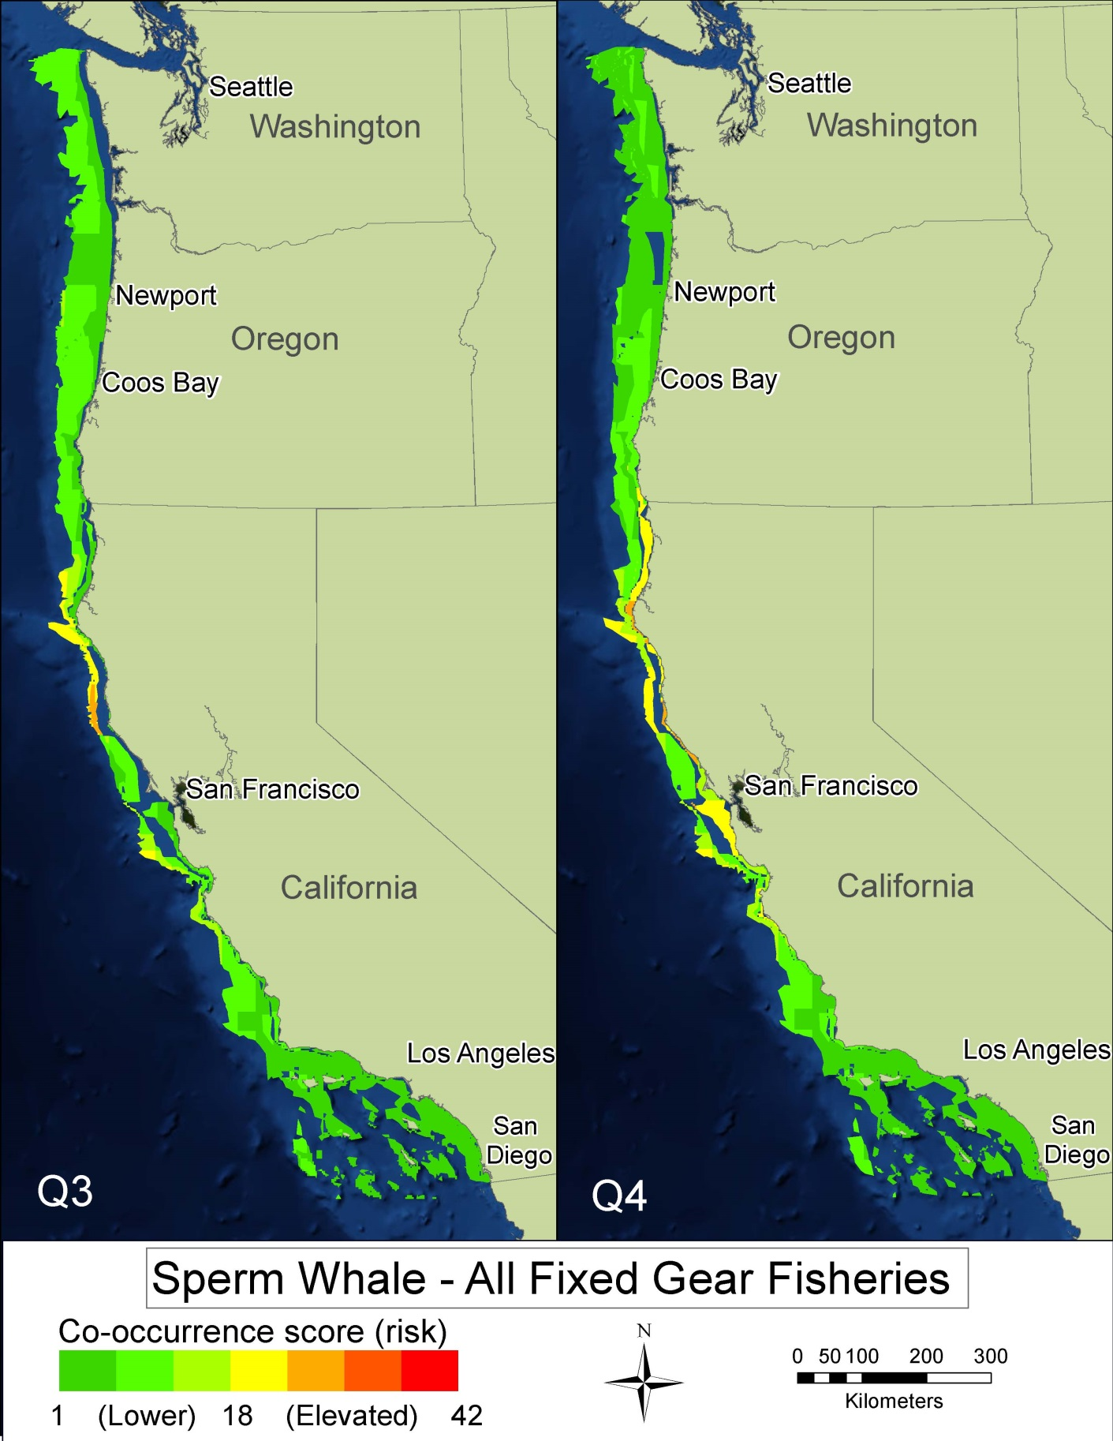
Co-occurrence map of sperm whales with all 11 fixed gear fisheries

Slide 8
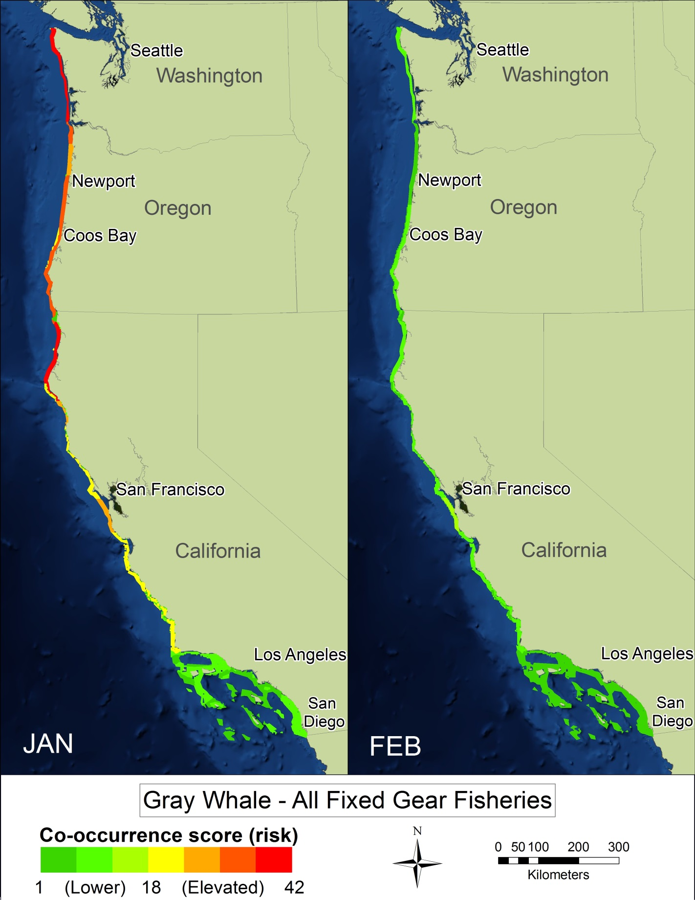
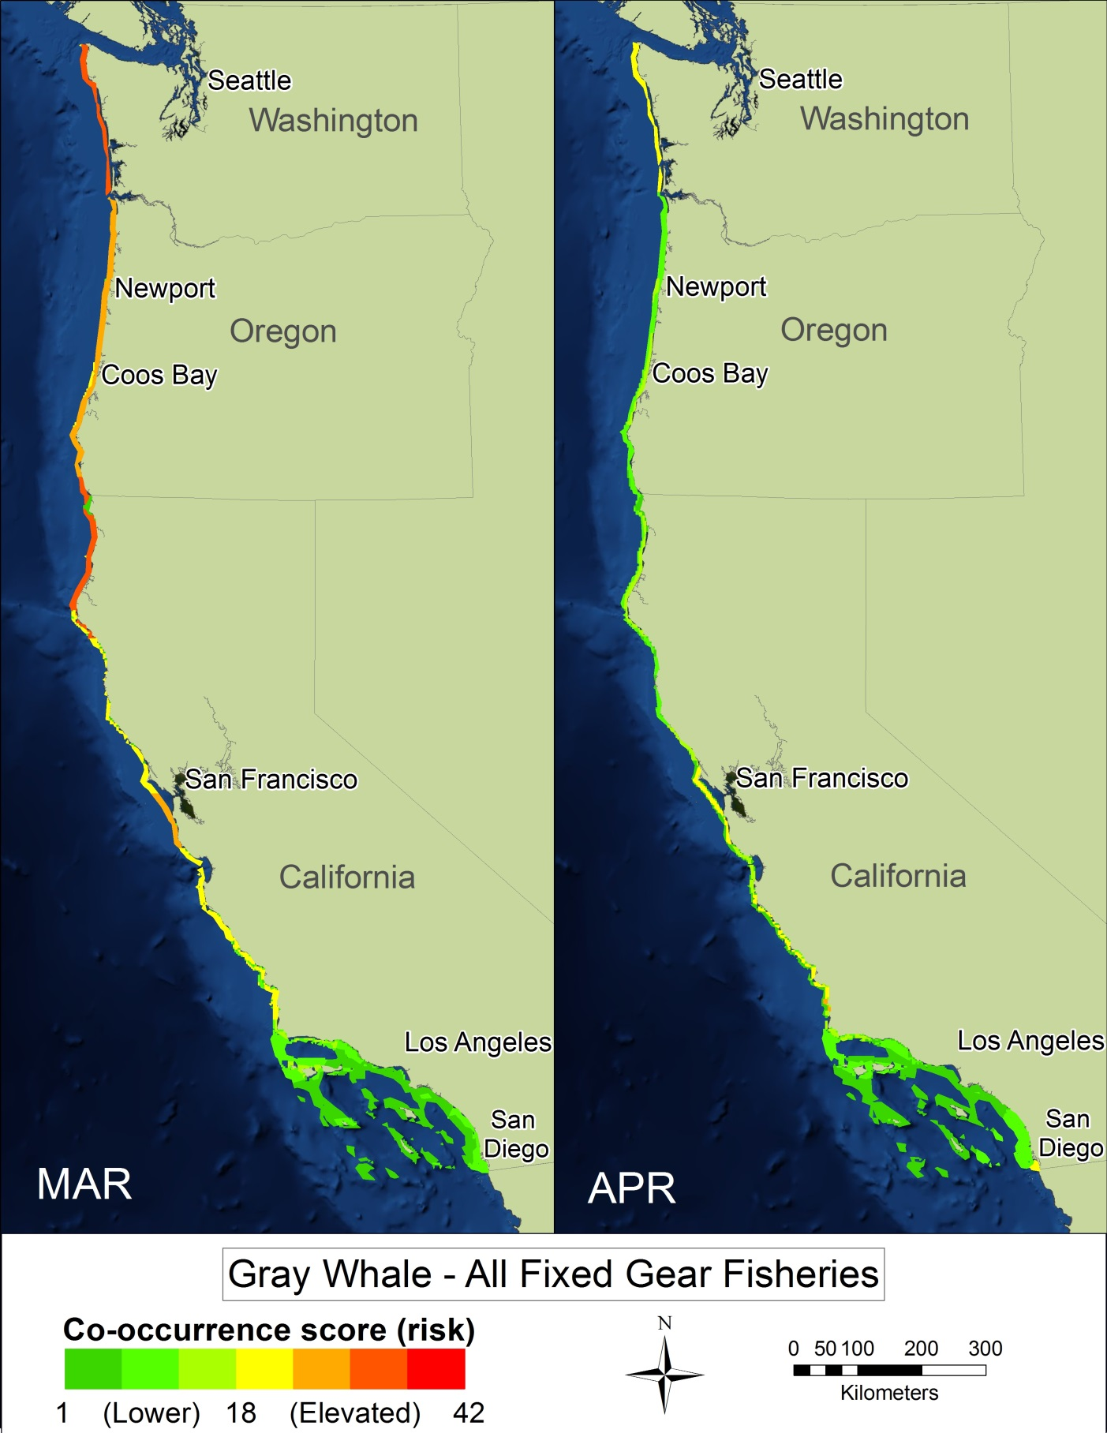
Co-occurrence map of gray whales with all 11 fixed gear fisheries

Slide 9
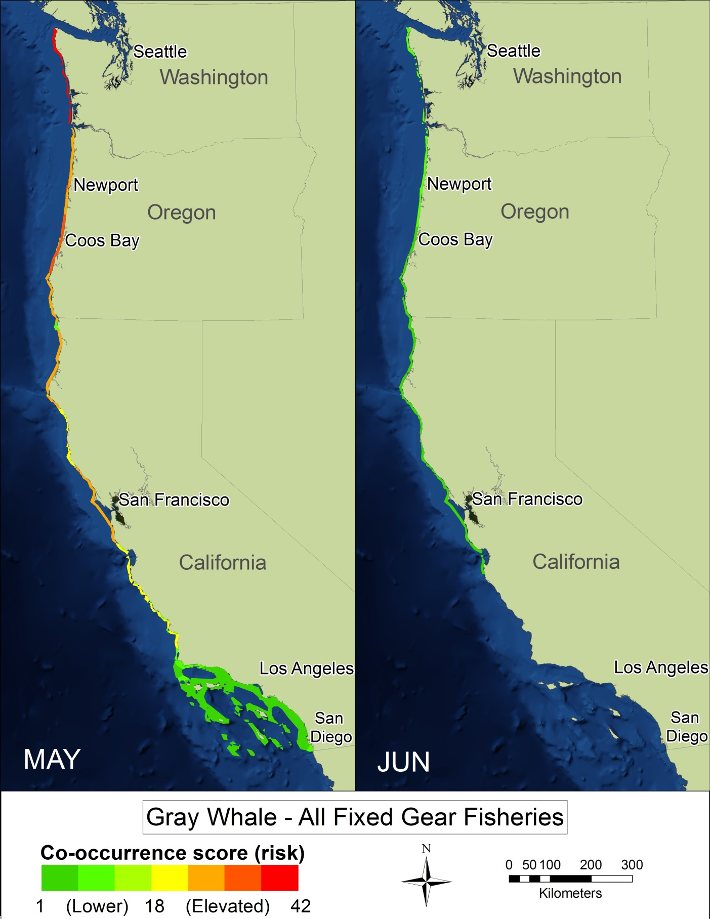
Co-occurrence map of gray whales with all 11 fixed gear fisheries

Slide 10
Results
The co-occurrence model identified species-specific spatial and temporal areas of low and elevated entanglement risk for individual fisheries as well as all fisheries combined
Underlying assumption is that entanglement risk is linearly related to the level of overlap (higher co-occurrence score = higher entanglement risk)
Dungeness crab trap fishery had the highest co-occurrence scores for all whale species included in the model
  Highest risk from San Francisco through coastal Washington
  Higher risk is a combination of higher fishing effort and relatively higher whale abundance

Slide 11
Results comparison to entanglement records
Co-occurrence model results were compared to 15 entanglement reports where fishery and general gear set location are known
All 15 reports were associated with co-occurrence model medium to high scores
This supports the use of the co-occurrence model for assessment of whale entanglement risk off the U.S. west coast
Map on next slide as example

Slide 12
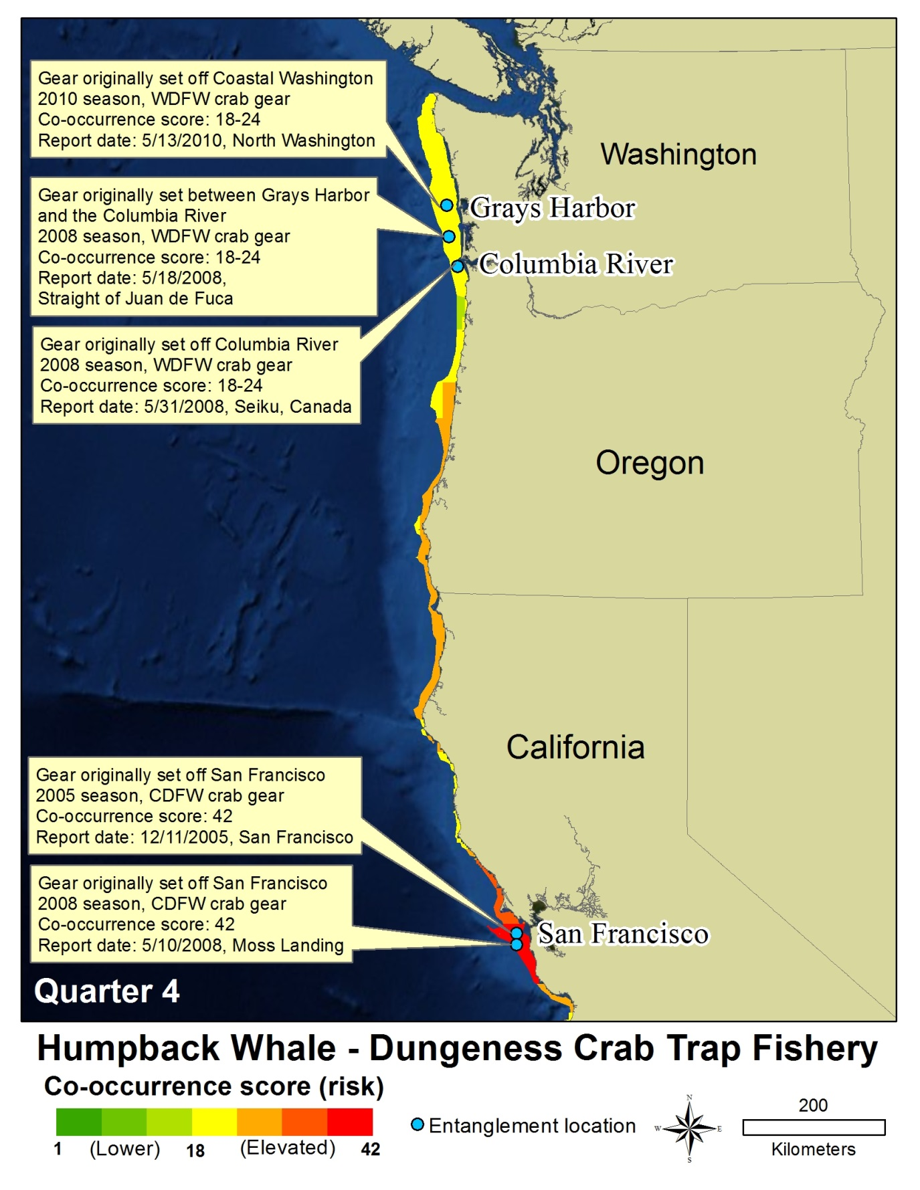
Humpback whale entanglement in Dungeness crab fishing gear records compared to co-occurrence model results
Blue dot indicates where entanglement occurred
Entanglements in medium to high co-occurrence areas (yellow to red)

Slide 13
Priorities for future contributions
Further investigate elevated risk areas and associated time periods identified by the co-occurrence model focused to understand and possibly mitigate large whale entanglements in the future.
Filling in data gaps for future co-occurrence modeling: include to the extent possible year-round density data for all species and available information on the Western Pacific gray whales and the Pacific Feeding Group of gray whales.
Continue gear research to understand mechanisms of large whale entanglements, and investigate the creation of a gear density-based fishery model.
Consider the feasibility of new/improved gear marking to assist in the identification and traceability of entangling gear.
Support future co-occurrence modeling efforts, especially with inclusion of research addressing the limitations of the co-occurrence model in this paper.
Improve reporting through increased public awareness and outreach; expand geographic coverage; and improved documentation and information collected from each entanglement report.

Slide 14
Any Questions?
NOAA West Coast Region’s marine mammal fisheries interaction page: http://www.westcoast.fisheries.noaa.gov/protected_species/marine_mammals/fisheries_interactions.html
Other resources include:
  the Fixed Gear Guide
  Whale in distress reporting hotline (877-SOS-WHALe)
  Derelict gear reporting hotline (855-542-3935)
  Marine mammal stranding network information

